Slide 1
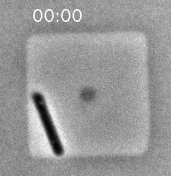
Eun, Garner, Amir, Schmid, et al, Nature Microbiology 2018
Notes:
First real-time imaging setup for extremophiles, archaea.

Slide 2
Microbial cell growth I
Nutrients and media
Logarithmic growth
Measuring cell growth
Culturing methods

Slide 3
How do harness the energy to grow?
Metabolism
The sum total of all of the chemical reactions that
occur in a cell
Catabolic reactions (catabolism)
Energy-releasing metabolic reactions
Anabolic reactions (anabolism)
Energy-requiring metabolic reactions
Most of what is known of microbial metabolism is based on study of
laboratory cultures

Slide 4
Nutrients
Supply of monomers (or precursors of) required by cells for growth
Macronutrients
Nutrients required in large amounts (C, N, P, S, etc)
Micronutrients
Nutrients required in trace amounts (e.g. trace metals)
Growth factors (Vitamins, amino acids, purines, pyrimidines)
Notes:
Go to periodic table on the wall and go through which nutrients are important

Slide 5
Types of media
Defined medium
All chemical components added are known
Minimal medium = only those components absolutely required for growth are included
Complex medium
Usually contains tryptone or yeast extract
Medium components are undefined but allow optimal growth.
We’ll use a complex medium with and without carbon source to test extremophile growth

Slide 6
Biosynthetic capacity
The ability of a microbial species to produce its own nutrients from precursors provided in the medium.
The higher the capacity, the fewer nutrients must be supplied (“simple nutritional requirements”)

Slide 7
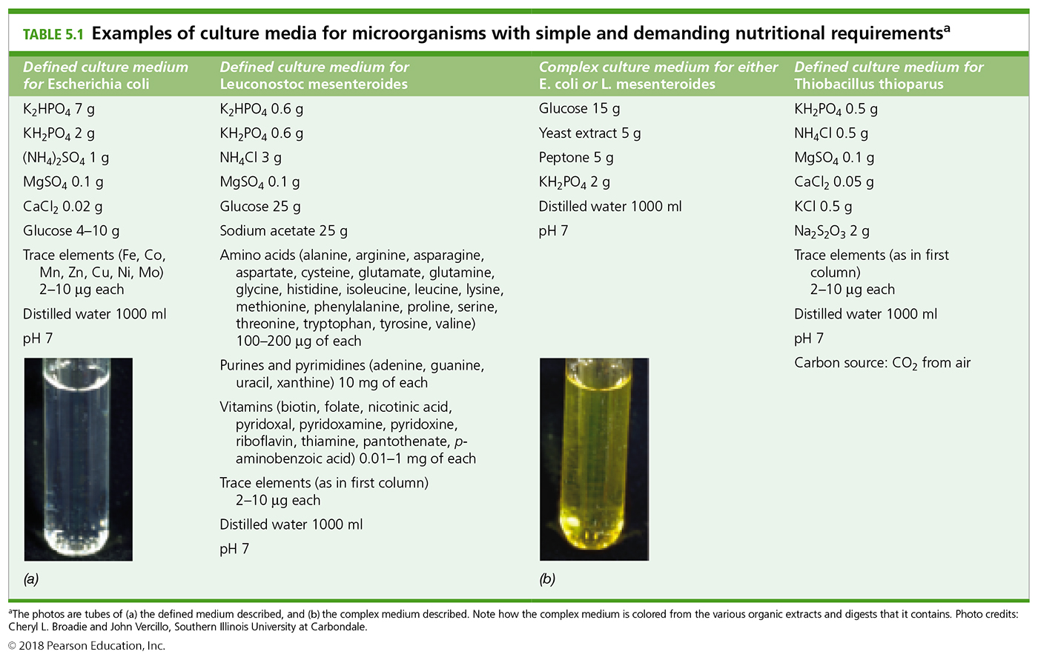
Which microbe has a higher biosynthetic capacity?
P
P
S/N
S
C
C
N
GF
Notes:
Much of this knowledge regarding microbes has been garnered from experimenting with culture growth: add some of this, ask whether it grows and how fast.

Slide 8
Nutritional requirements for bacterial growth
carbon source
- autotrophs: an organism capable of biosynthesizing all cell material from CO2 as the sole source of carbon. (Please note the difference from auxotroph).
- heterotrophs: an organism requiring organic compounds as a carbon source.
energy source
- chemolithotroph: an organism which uses inorganic chemicals as energy sources (electron donors).
- chemoorganotroph: an organism which uses organic chemicals as energy sources (electron donors).
- phototroph: an organism capable of using light as an energy source.
Most eukaryotes either photoautotrophic (plants, algae) or heterotrophic (animals, protozoa, fungi).
Lithotrophy is unique to bacteria and archaea.
Photoheterotrophy, common in purple and green Bacteria, occurs only in a very few eukaryotic algae.

Slide 9
Major nutritional types of prokaryotes

Slide 10
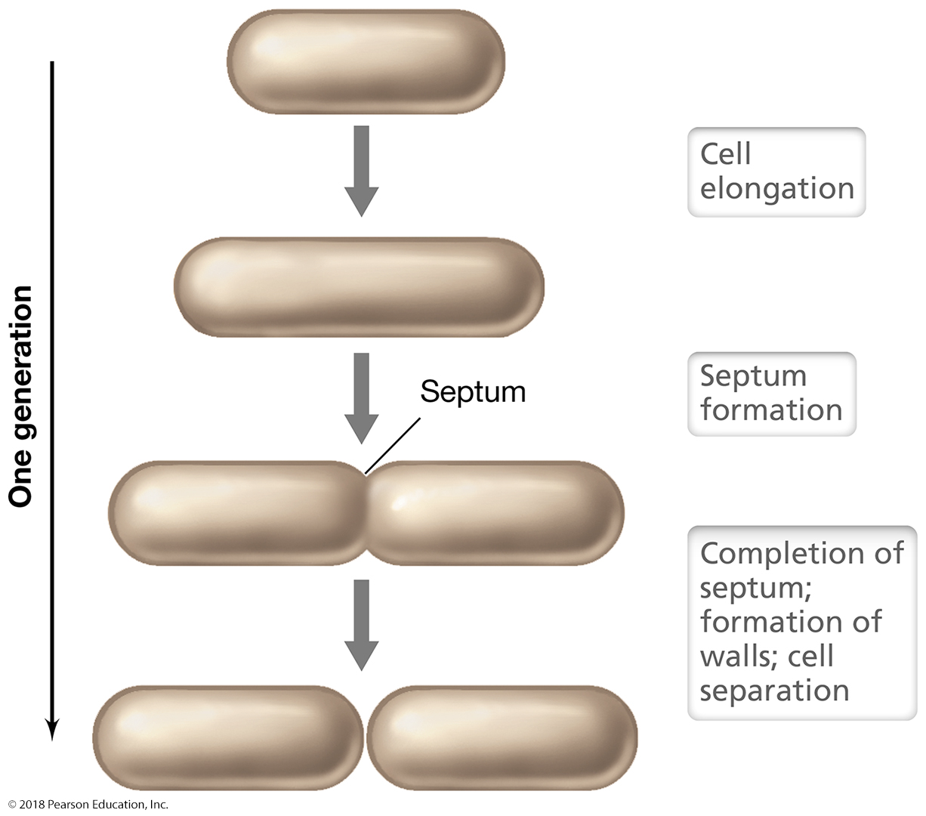
Once they have energy, microbial cells grow by binary fission
Other ways to grow:
Cell cycle (mitosis)
Budding
Fragmentation
Sporulation

Slide 11
Bacterial and Archaeal cells grow by binary fission
Eun, Garner, Amir, Schmid, et al, Nature Microbiology 2018
Notes:
First real-time imaging setup for extremophiles, archaea.

Slide 12
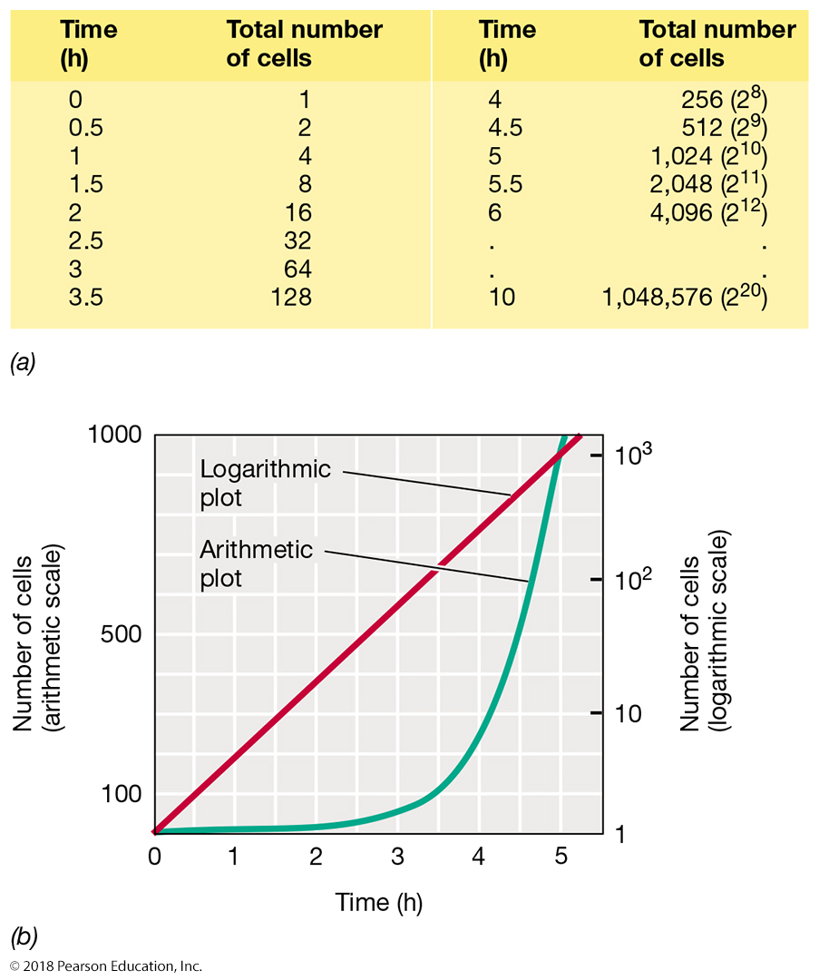
Calculating exponential growth

Slide 13
The four phases of growth
Zweitering et al., 1990, J Bacteriol

Slide 14
Calculating exponential growth
N_{t} = N₀ x 2^{n}
where N_{t} = Number of cells at time t; N₀ = number of cells at start; and n = number of cell generations
Doubling time or generation time - the time needed for a population to double: g = t/n
Division rate (µ) – number of generations per unit time (h⁻¹)
Optimal doubling time for E. coli = 20-30 min, for yeast = 1 hr, for Haloferax volcanii ~2 hr.
In 24 hrs E. coli can divide for 72 generations
= 4.7 x 10²¹ cells!!
log N_{t} = logN₀ + n log2
n = (log N_{t} – logN₀) / 0.301

Slide 15
Calculating growth
A cell culture has grown from OD600 0.25 to 1.0 in 24 hours. What is its generation (doubling) time? How many generations have elapsed?
Notes:
Also mention milk spoiling fast as a practical example of logarithmic growth.

Slide 16
All points on the growth curve can be used for more accurate quantitation of the growth parameters
𝛌 = lag
𝛍m = maximum instantaneous growth rate (peak of 1st derivative curve)
𝚨 = Asymptotic carrying capacity
Many regression methods to do this:
Logistic regression
Gompertz regression
Zweitering et al., 1990, J Bacteriol

Slide 17
Cell growth in the lab
Batch culture – Growing cells together in a flask in a liquid nutrient broth.
Plate growth – Growing cells in individual colonies on a solid support (agar)
There are other ways to grow cells in lab but the first two are relevant to our experiment

Slide 18
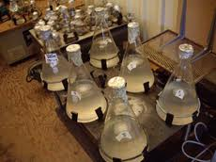
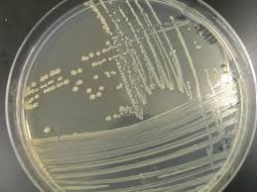
Growing cultures in the lab
BATCH
PLATE

Slide 19
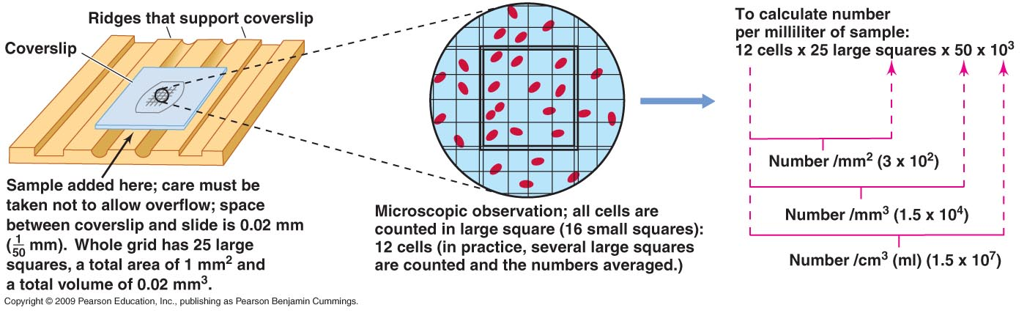
Direct counts – used frequently for environmental samples
Advantages
Quick and easy
Get direct counts
Disadvantages
Requires staining to distinguish live/dead
Motile organisms must be immobilized
Doesn’t work well at low densities

Slide 20
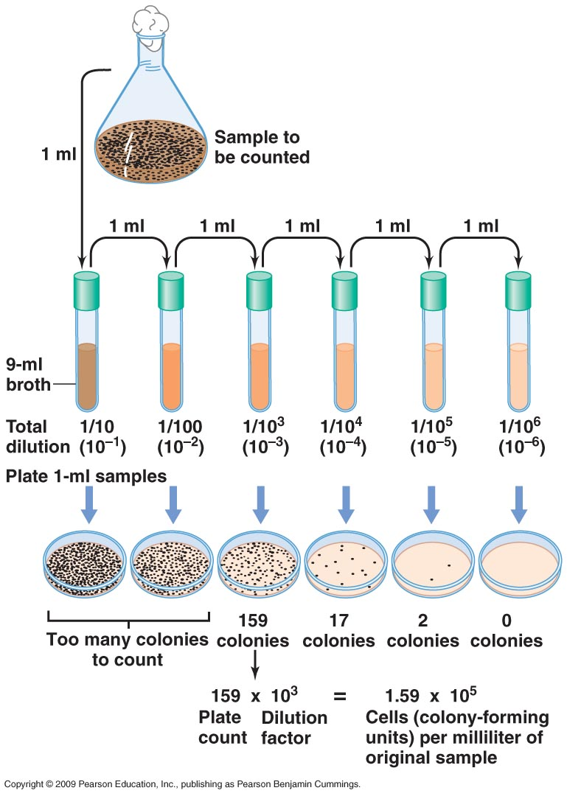
Plate counts
Advantages
Can distinguish live/dead
Reliable counts when growth
conditions are known
High sensitivity
Disadvantages
Highly misleading for mixed
cultures (the Great Plate
Count Anomaly)
Can take a long time for
slower-growers
Can’t be used for unculturable organisms

Slide 21
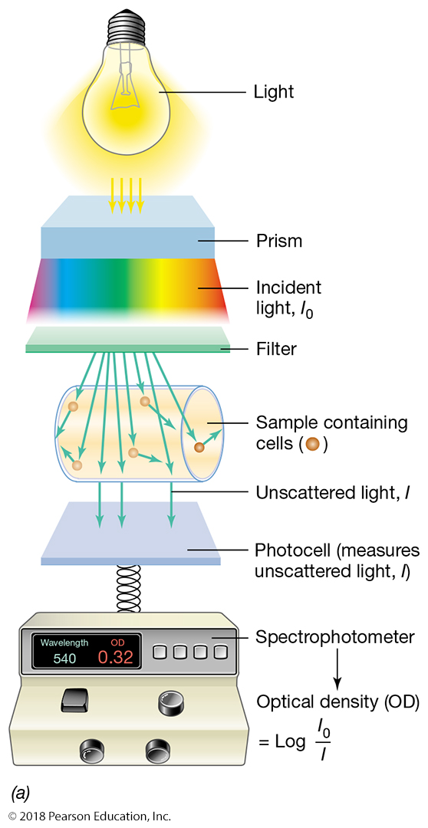
Spectrophotometer
Advantages
Sensitive
Can be done on live
cultures
Quick and easy
Proportional to direct counts
Can use the instrument for
quantifying other samples
(e.g. DNA, protein, enzyme
activity)
Disadvantages
Does not distinguish live/dead
unless there is lysis.
Misleading if clumps or flocs

Slide 22
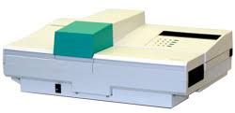
The Bioscreen
High throughput growth curves
200 at once, automated readings every 30 mins

Slide 23
The four phases of growth
Plate counts (viable count) and spec (OD or turbidity) might yield different answers
For log phase, stat phase, and death phase, but they should yield the same
Growth rate for exponential phase. That’s why microbial physiology is usually
Determined by growth rate in exponential phase – “balanced growth”

Slide 24
Extreme growth activity
Let’s look at an infographic together about microbial extremophiles
Download Schmid et al 2020 Cell Snapshot from the wiki
Break into groups of 3.
Each group looks in greater detail at the infographic to learn about one of the extreme conditions (~10 mins)
Report back to the group:
Two amazing facts you learned that you didn’t know before
One question you have that you are curious about.

